Slide 1
Anomaly Detection in Videos
Team:
Priyesh Kaushik
Haroon Perveez
Neelam Babel

Slide 2
Introduction
Videos are basically multiple frames in a sequence which have several objects in them at any given moment. As part of this project, we propose a spatiotemporal architecture for anomaly detection in videos including crowded scenes.

Slide 3
Our Scope
Convert videos into frames
Learn spatial and temporal features per batch of frames
Detect the anomalous batch of frames and
Convert the anomalous batch into a gif

Slide 4
Our Approach - Dataset
We chose Avenue Dataset which has 21 training videos and 16 testing videos
The training dataset does not contain any anomalies
The normal scenes consists of people walking between staircase and subway entrance whereas the abnormal events are people running, walking in opposite directions, loitering etc
The dataset can be found on the below link :
http://www.cse.cuhk.edu.hk/leojia/projects/detectabnormal/dataset.html

Slide 5
Approach – Model Implementation
We are using Spatial Temporal Convolution Technique to detect anomalies
In our model, spatial encoder and decoder have two convolutional and deconvolutional layers respectively, and the temporal encoder is a 3 layer convolutional LSTM model
The model is trained using back-propagation in an unsupervised manner, by minimizing the reconstruction error of the decoded results from the original inputs

Slide 6
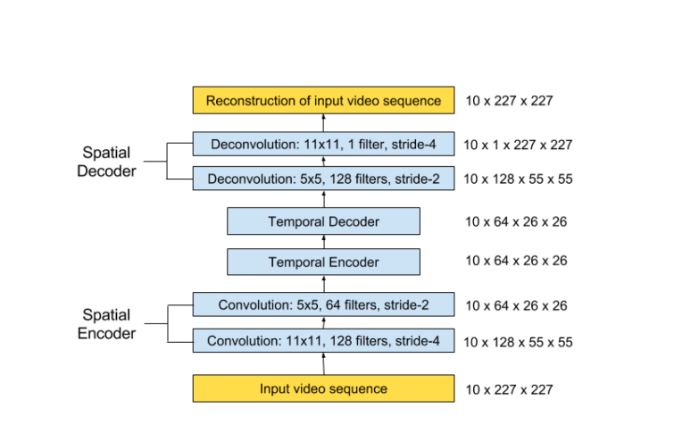
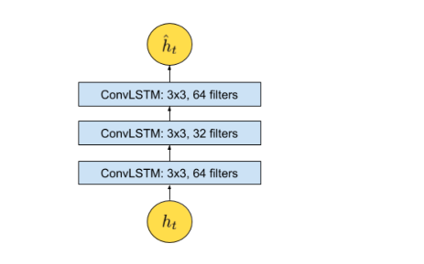

Slide 7
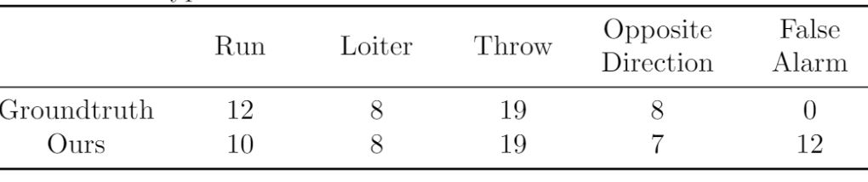
Analysis of the Model

Slide 8
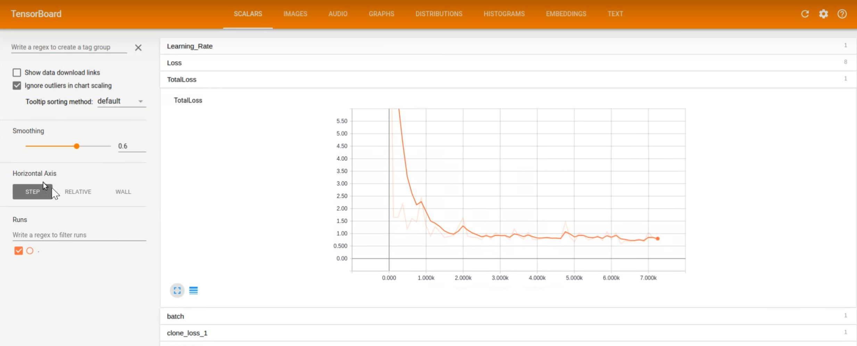
Tensorboard Graph for

Slide 9
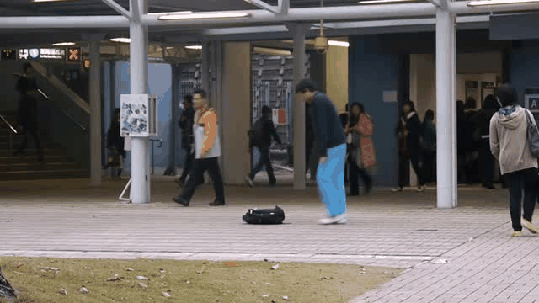
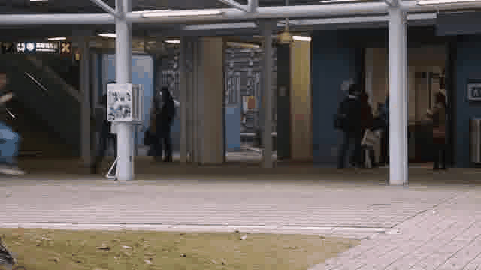
What we did with this

Slide 10
How we made it
The video uploaded is converted into frames using JavaScript and the blob files of 10 frames at a time are sent to the server with a POST request
The images are then converted in numpy Arrays which are feeded into the model
Anomalous Bunch is detected by calculating the reconstruction error and thresholding
A gif is created from the anomalous frames and encoded to Base64 string which is rendered on the browser using JavaScript

Slide 11
Start Anomaly Detection
Client
Side
WebRTC
Flask Application
Image Stream
Render on Browser using JS
Client
Side
Return gif Base 64 string
Detect Anomalous Bunch and create a GIF

Slide 12
Further down the line
This application can be used in video surveillance to detect abnormal events as it’s based on unsupervised learning, the advantage being that the only ingredient required is a long video segment containing only normal events in a fixed view
Achieve better performance by pruning the model
Localize the anomalies and draw bounding boxes

Slide 13
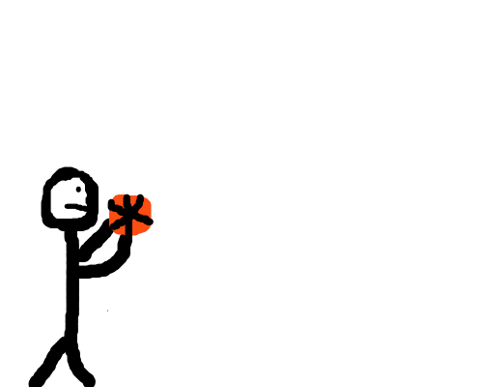
Have Questions?

Slide 14
Thank you!

